Slide 1

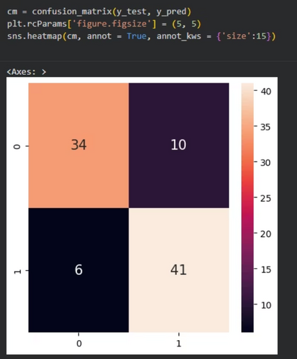
Predicting Heart Disease: A Machine Learning Approach
Heart disease remains a global health crisis, making early and accurate diagnosis paramount for life-saving interventions. This presentation outlines the development of a diagnostic machine learning tool designed to predict the presence of heart disease, aiding medical professionals in critical decision-making.
1
2
The Challenge
The Data
Heart disease is a leading cause of mortality worldwide. Early detection is critical for
Our model leverages the UCI Heart Disease dataset, comprising 14 crucial clinical attributes from 303 diverse patients, ensuring a robust foundation for analysis.
life-saving interventions and improved patient outcomes.
3
The Goal
To accurately classify patients into "Disease" (target = 1) or "No Disease" (target = 0) categories, enhancing diagnostic precision for clinicians.
Notes:
1

Slide 2
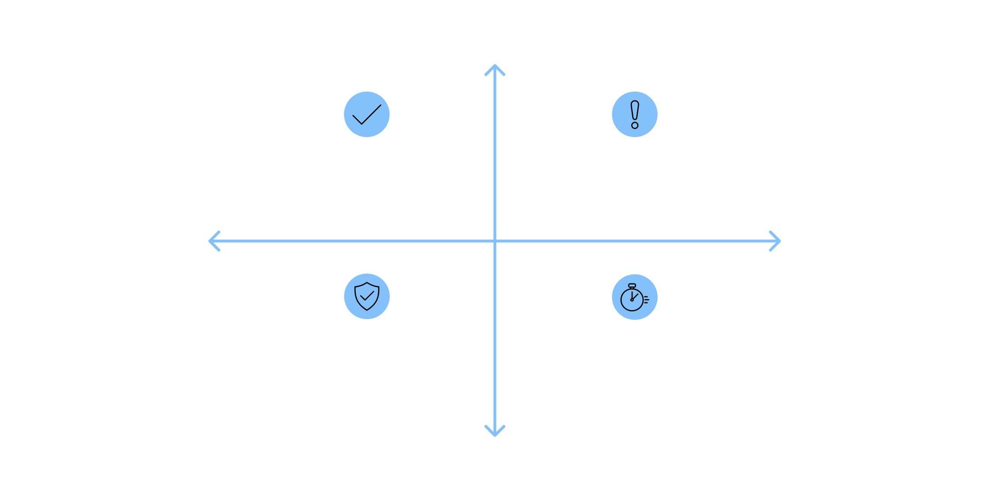




Evaluating Model Performance: The Confusion Matrix
Understanding how well our machine learning model performs requires precise metrics. The confusion matrix is a fundamental tool for evaluating the classification accuracy of our heart disease prediction model, providing a detailed breakdown of its predictions.
Actual: Disease
True Positives (TP): 34
False Negatives (FN): 10
Predicted: No Disease
Predicted: Disease
True Negatives (TN): 41
False Positives (FP): 6
Actual: No Disease
This matrix visually summarizes the results, allowing us to see not just correct predictions but also the types of errors made.
True Positives (TP)
True Negatives (TN)
Correctly predicted that the patient has heart disease (Actual: Disease, Predicted: Disease).
Correctly predicted that the patient does not have heart disease (Actual: No Disease, Predicted: No Disease).
False Positives (FP)
False Negatives (FN)
Incorrectly predicted that the patient has heart disease (Actual: No Disease, Predicted: Disease). This is a Type I error.
Incorrectly predicted that the patient does not have heart disease (Actual: Disease, Predicted: No Disease). This is a Type II error.
Notes:
2

Slide 3





Key Performance Metrics for Heart Disease Prediction
Beyond the raw numbers of the confusion matrix, several derived metrics offer deeper insights into our model's effectiveness, highlighting strengths and areas for improvement in diagnosing heart disease.
Accuracy
Overall correct predictions. Useful, but can be misleading if the dataset is imbalanced. ~ 84%
Precision
Proportion of positive predictions that were actually correct. Minimizes false alarms, crucial for patient peace of mind. ~ 82%
Recall (Sensitivity)
Proportion of actual positive cases correctly identified. Crucial for not missing true heart disease cases.
Specificity
Proportion of actual negative cases correctly identified. Important for confirming healthy patients are truly healthy.
F1-Score
Harmonic mean of precision and recall. Provides a balanced measure, especially when classes are uneven.
These metrics collectively paint a comprehensive picture of our model's diagnostic capabilities.
Notes:
3

Slide 4




Integrating ML into Clinical Practice
This predictive model is designed to seamlessly integrate into existing healthcare workflows, offering tangible benefits for both medical professionals and patients, ultimately driving improved health outcomes.
Data Input & Analysis
AI Prediction & Insight
Patient clinical data is securely fed into the system for rapid, automated processing and risk assessment. This reduces manual burdens and streamlines initial evaluations.
The machine learning model generates an objective risk score or probability of heart disease, highlighting key contributing factors. It provides consistent, data-driven insights.
Clinician Review & Decision
Enhanced Patient Care
Medical professionals integrate the model's insights with their expertise, patient history, and other diagnostic tests to formulate an informed diagnosis and treatment plan.
Early and accurate diagnosis facilitates timely interventions, personalized care strategies, and preventative measures, leading to better patient outcomes and reduced healthcare costs.
Successful deployment hinges on thoughtful implementation, addressing regulatory, ethical, and practical considerations to ensure trust and effectiveness.
Notes:
4

Slide 5





Shaping the Future of Heart Health
Our journey into machine learning for heart disease prediction culminates in a powerful vision for healthcare transformation. This model represents a significant step towards a future where early, accurate diagnosis is not just an aspiration, but a standard practice.
Revolutionizing Diagnostics
Empowering Clinical Decisions
Expanding Horizons
Future directions include integrating with electronic health records, continuous model refinement, and extending predictive capabilities to other chronic conditions.
Machine learning is pivotal in processing complex medical data, identifying subtle patterns indicative of disease earlier than traditional methods.
Our model offers clinicians a robust, data-driven tool to enhance diagnostic accuracy, leading to more targeted and effective patient care strategies.
By embracing these advancements, we can significantly improve patient outcomes and pave the way for a more proactive and personalized healthcare system.
Notes:
5

Slide 6
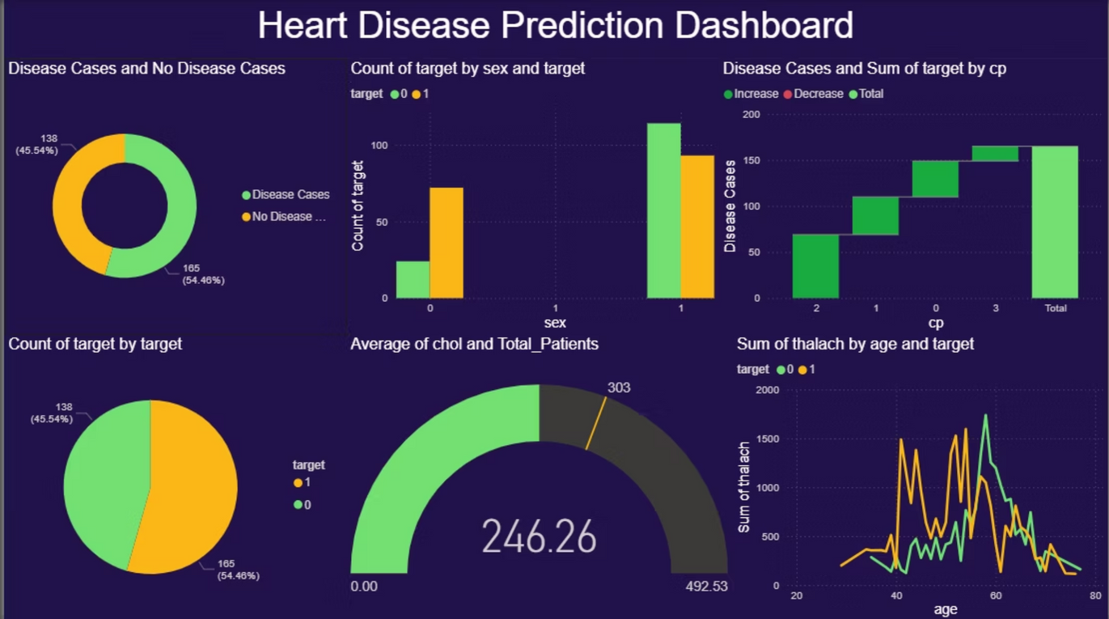



Data Visualization & Analytics: Power BI Dashboard
Our interactive Power BI dashboard provides a comprehensive and intuitive interface to monitor the heart disease prediction model's performance and glean insights from patient data in real-time.
Performance Monitoring
Demographic Insights
Track disease and no-disease cases to assess the model's accuracy and identify trends over time.
Analyze predictions by sex and other variables to understand population-specific patterns and impacts.
Clinical Factor Analysis
Actionable Insights
Visualize average cholesterol, oldpeak values, and disease types for deeper clinical understanding and risk assessment.
Empower clinicians with rapid, data-driven insights to make informed decisions and enhance patient care strategies.
Notes:
6

